Slide 1


 | Nitte Meenakshi Institute of Technology (AN AUTONOMOUS INSTITUTION AFFILIATED TO VISVESVARAYA TECHNOLOGICAL UNIVERSITY, BELGAUM) PB No. 6429, Yelahanka, Bangalore 560-064, Karnataka Telephone: 080- 22167800, 22167860, Fax: 080 - 22167805
Department of Computer Science and Engineering
Attendance Monitoring System Using Facial Recognition
Project Group No:- 21-CSP14
Presentation By:
PIYUSH KUMAR NAYAN 1NT19CS135
GUNDU RAO M G 1NT19CS102
SPOORTHI SAJJAN 1NT19CS186
PRINCE KUMAR 1NT19CS
Guided By:
Name of the Guide: DR.SAROJADEVI
Designation: PROFESSOR

Slide 2
Contents
Introduction
Research Motivation
Problem Statement
Research Objectives
IMPLEMENTATION
RESULTS
Conclusion
LITERATURE SURVEY
REFERANCES

Slide 3
INTRODUCTION
The purpose of the attendance monitoring system using face recognition is to ease the attendance process which consumes lot of time and efforts by the lecturer which can be utilized in teaching
The system will capture the images of the students present in the classroom and using face recognition algorithm mark the attendance in the sheet
The user of this system is lecturer, admin, students.

Slide 4

Research Motivation
The motivation behind this proposed work comes from the advancement of technologies like image processing, AI and machine learning and Face unlock feature given by smart-phone manufacturers.
The classroom often consists of huge number of students which usually takes a lot of time thus creating a system which will automatically detect the present students and then marking the students accordingly will be very helpful, Just like staff Id scanning but way too easier than that.
So Smart Attendance using Real Time Face Recognition is a real world solution which comes with day to day activities of handling employees.
This product gives much more solutions with accurate results in user interactive manner rather than existing attendance and leave management system

Slide 5
PROBLEM STATEMENT
Design and Development of an attendance monitoring system using facial recognition.

Slide 6
RESEARCH OBJECTIVES
No pre-processed data, creating own data frames from small scale to large scale.
Deciding productivity enhancing measures as a suggestion alert.
Generating reports.
Analyzing data to study patterns.
Formulating suggestion alerts.

Slide 7
FOR LITERATURE SURVEY
S.No. | Title |  | Advantages | Disadvantages
1 | A comparative study between four machine learning methods for face detection |  | Real time human face recognition using LBPH (Local Binary Pattern Histogram) | . Limited head pose
2 | Smart Attendance Monitoring System using viola jones and deep learning |  | System performs satisfactorily with different facial expressions, lighting and poses. | Sometimes fails to recognize every face of the student in the class
3 | Automated attendance system using image processing |  | Recognize the faces with 90% accuracy | Difficult to recognize blur faces
4 | Eye-Tracking Data Analytics for Human Fatigue Detection at a Traffic Control Center |  | Efforts and time taken for attendance is reduced | Sensitive to lighting

Slide 8
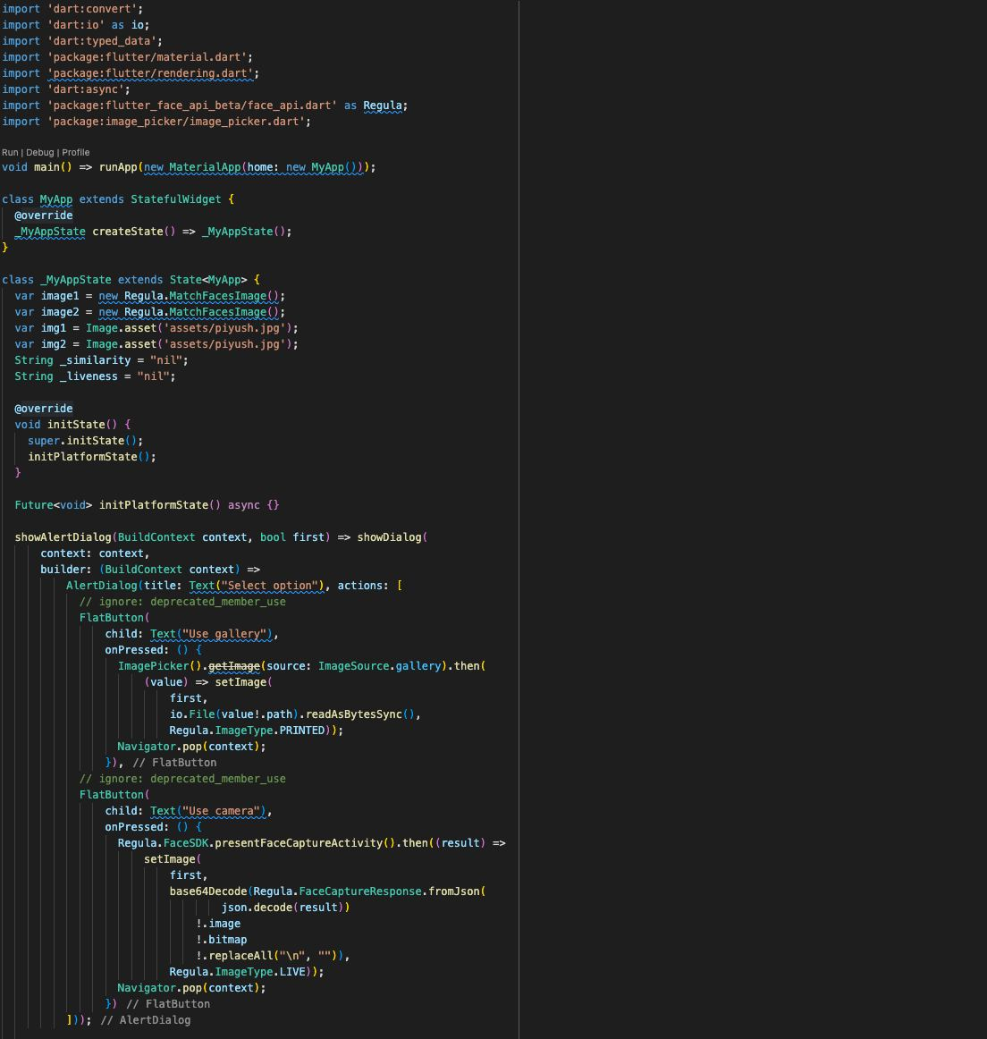
IMPLMENTATION

Slide 9
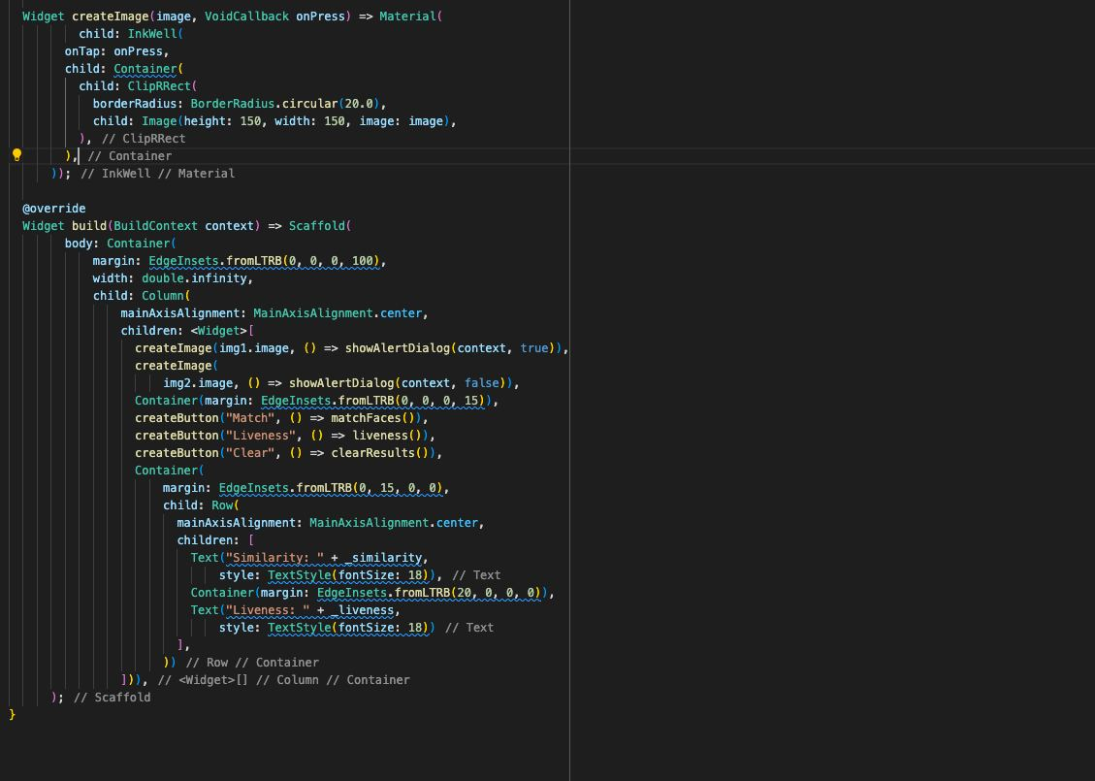
IMPLMENTATION

Slide 10
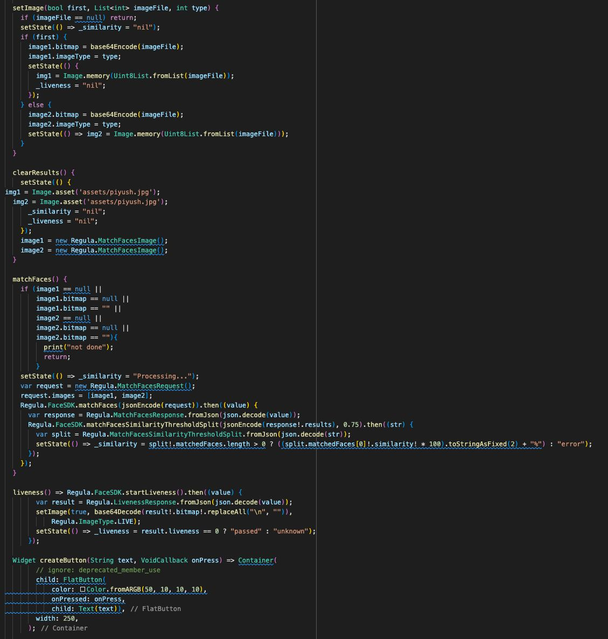
IMPLMENTATION

Slide 11
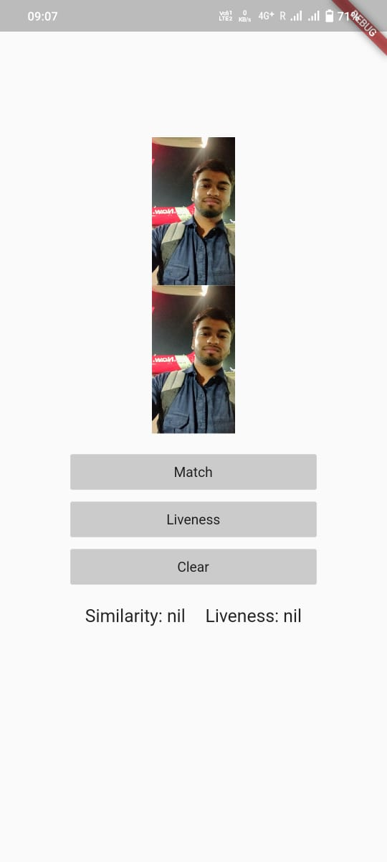
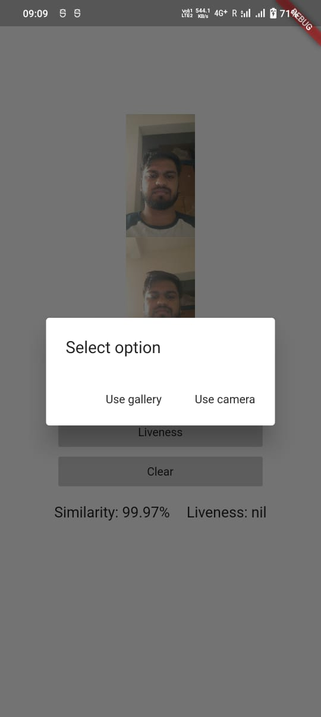

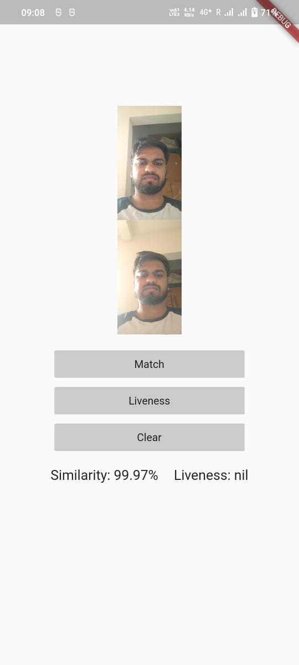
RESULTS

Slide 12
CONCLUSION
Face Based Attendance Management System using Machine Learning thus proved to be time saving and cost effective
This paper introduces the efficient method of attendance management system in the classroom environment that can replace the old manual methods.
There is no need for specialized hardware for installing the system in the classroom. It can be constructed using a camera and computer
This method is secure enough, reliable, accurate and efficient
This project has promising results upon achievement of mentioned objectives.

Slide 13
References
[1] Shireesha Chintalapati, M.V. Raghunadh, Automated Attendance Management System Based on Face Recognition Algorithms, 2013 IEEE International Conference on Computational Intelligence and Computing Research, 978-1-4799- 1597- 2/13/$31.00 ©2013 IEEE
[2] Hajar Filali Jamal Riffi Adnane Mohamed Mahraz Hamid Tairi, Multiple face detection based on machine learning, 978-1-5386-4396-9/18/$31.00 c 2018 IEEE
[3] Shubhobrata Bhattacharya, Gowtham Sandeep Nainala, Prosenjit Das and Aurobinda Routray, Smart Attendance Monitoring System (SAMS): A Face Recognition based Attendance System for Classroom Environment, 2018 IEEE 18th International Conference on Advanced Learning Technologies, 2161- 377X/18/$31.00 ©2018 IEEE DOI 10.1109/ICALT.2018.00090
[4] Aftab ahmed, Jiandong guo, Fayaz ali, Farha deeba, Awais ahmed, LBPH Based Improved Face Recognition At Low Resolution, International Conference on Artificial Intelligence and Big Data, 978-1-5386-6987-7/18/$31.00 ©2018 IEEE
[5] Hemantkumar Rathod, Yudhisthir Ware, Snehal Sane, Suresh Raulo, Vishal Pakhare and Imdad A. Rizvi, Automated Attendance System using Machine Learning Approach, 2017 International Conference on Nascent Technologies in the Engineering Field (ICNTE-2017), 978-1-5090-2794- 1/17/$31.00 ©2017 IEEE.
[6] Poornima S1, Sripriya N2, Vijayalakshmi B3,Vishnupriya P4, Attendance Monitoring System using Facial Recognition with Audio Output and Gender Classification, IEEE International Conference on Computer, Communication, and Signal Processing (ICCCSP-2017), 978-1-5090-3716-2/17/$31.00 ©2017 IEEE

Slide 14
